Slide 1


Design and Implementation of an Intelligent Street Lighting System with Automated Illumination Control Based on Ambient Light and Environmental Conditions
Presented by:
S HARSHIT (192312612)
Supervisor:
Dr. S Maheswari
Dr. N kapileswar
ECA0803-Analog and Digital Communication for Cognitive Radio
Institution:
SIMATS ENGINEERING Date: [13/08/2025]

Slide 2
Introduction
Automatic street lights are lighting systems that turn on and off based on ambient light levels.
These systems can also include timers and motion sensors to enhance efficiency.
By conserving energy during daylight hours, they contribute to sustainability.
Additionally, they improve safety and visibility for pedestrians and drivers at night.

Slide 3
Hardware Components
Arduino Nano – microcontroller board
3 × IR Sensors – for proximity or obstacle detection
3 × LED Lights – visual indicators
1 × LDR Module – light intensity sensing
Jumper Wires – for connections
Breadboard – for prototyping
Power Supply – to power the circuit

Slide 4
Architecture / Configuration
Arduino Nano Sensors: IR sensors detect movement; LDR measures ambient light levels.
Controller: Arduino Nano processes inputs and controls lighting.
Lighting Units: LEDs switch ON/OFF or dim based on controller commands.
Power Supply: Provides regulated power to all components.
Connections: Jumper wires and breadboard used for prototyping and integration.

Slide 5
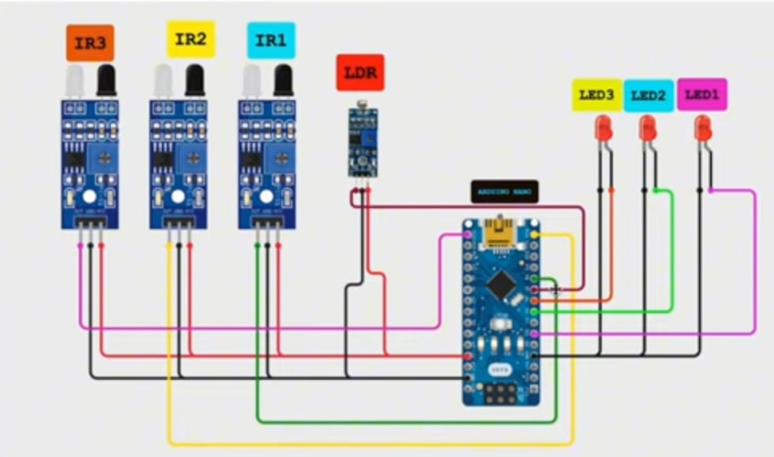
Circuit Diagram

Slide 6
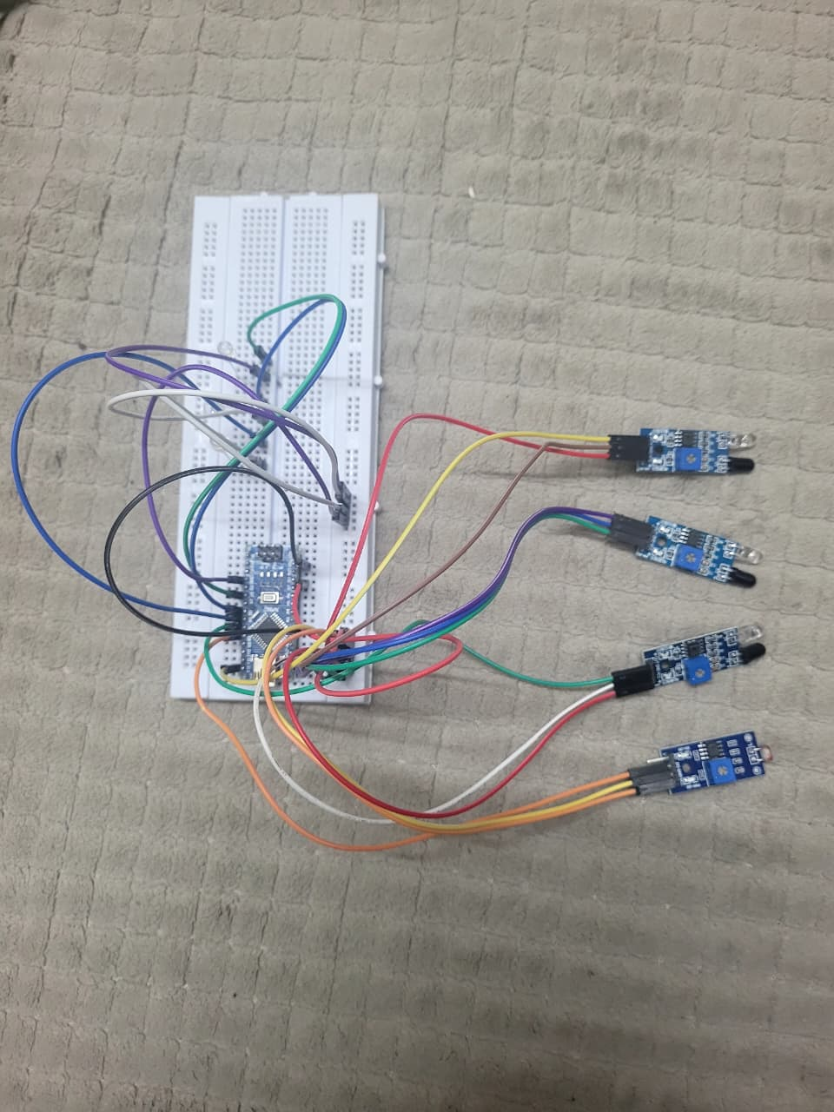
Hardware Implementation

Slide 7
Challenges and Solutions
False triggering from rain, dust, or small animals → Sensor calibration & noise filtering.
Power interruptions → Backup with rechargeable batteries or solar panels.
Low visibility issues in fog/rain → Use higher-sensitivity or multiple sensor types.
Scalability limits → Modular design for easy expansion & smart city integration.

Slide 8
Application
Urban and rural street lighting – improves safety and visibility at night.
Highway and expressway illumination – ensures smooth traffic flow after dark.
Campus and industrial area lighting – enhances security and reduces costs.
Smart city projects – integrates with IoT for automated monitoring and control

Slide 9
Conclusion
Enhances efficiency, safety, and sustainability in urban infrastructure through smart lighting control.
Reduces energy consumption and operational costs by utilizing advanced sensors and automation.
Improves public safety and urban quality of life with adaptive street lighting.
Supports smart city initiatives by offering scalable, innovative solutions for future urban challenges.

Slide 10
THANK YOU

